Slide 1
MCA Final Year Project (Review I) AI-Powered Mood-Based Music Recommender Using Facial Emotion Recognition
Submitted to the Presidency University, Bengaluru in partial fulfillment for the award of the degree of Master of Computer Applications(MCA)
Project Number : 223
Under the supervision of
Mr. Sakthi S Asst. Prof, Department of SCSE School of Computer Science and Engineering
Name | Roll Number
Meghana M | 20232MCA0059

Slide 2
Content
Problem Statement
Literature Survey
Tools and Technologies to be used
Timeline of the Project
GitHub Link
References

Slide 3
Problem Statement
Existing music recommendation systems depend on user input, playlists, or listening history, which may not reflect real-time emotions.
This project, "Personalized Mood-Based Music Recommender with Face Recognition," aims to detect a user's mood and suggest music accordingly.
Using computer vision and machine learning, the system analyzes facial expressions to identify emotions like happiness, sadness, anger, or neutrality.
Based on the detected mood, it automatically recommends a playlist that matches the user's emotions, creating a more personalized experience.
This hands-free approach enhances user satisfaction by providing real-time, mood-based music recommendations.

Slide 4
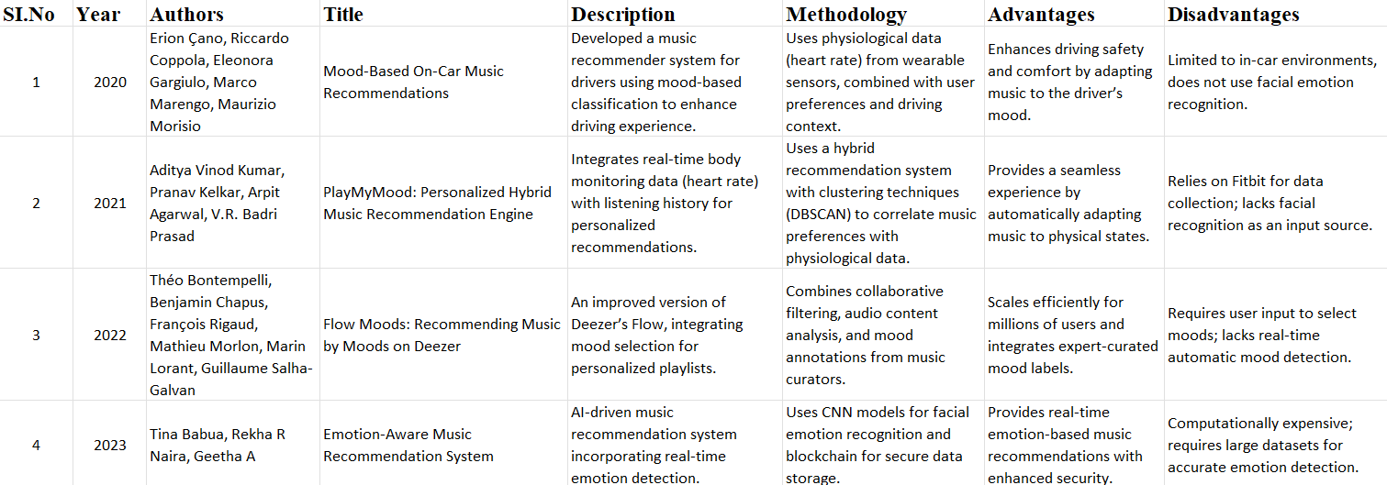
Literature Review

Slide 5
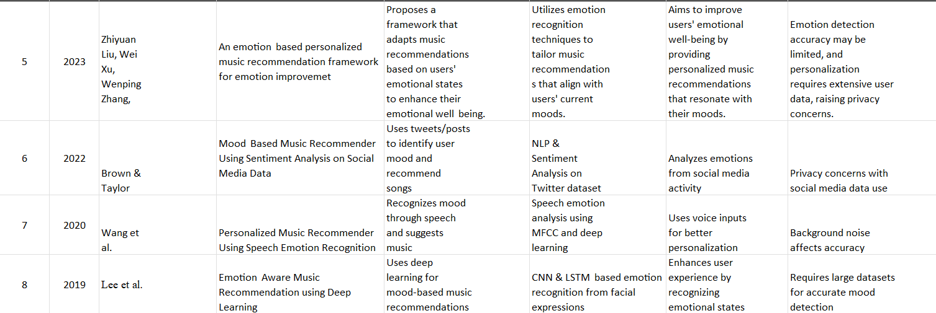

Slide 6
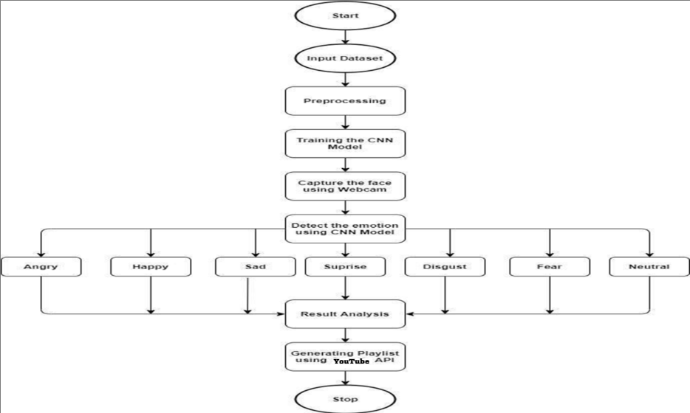
Module Design
|

Slide 7
Start
The system begins execution.
Input Dataset
A dataset containing facial images with labeled emotions is provided as input for model training.
Preprocessing
The facial images undergo preprocessing techniques like noise reduction, resizing, and normalization to improve model accuracy.
Training the CNN Model
A Convolutional Neural Network (CNN) is trained on the preprocessed dataset to classify facial expressions into different emotions.
Capture the Face Using Webcam
The system captures real-time facial images using a webcam.

Slide 8
Detect the Emotion Using CNN Model
The trained CNN model analyzes the captured face and classifies the detected emotion.
Emotion Classification
The detected emotion is categorized into one of the following:
Angry, Happy, Sad, Surprise, Disgust, Fear, Neutral
Result Analysis
The classified emotion is analyzed to determine the most suitable music playlist.
Generating Playlist Using Spotify API
Based on the detected emotion, a corresponding playlist is retrieved using the YouTube API.
Stop
The process ends after playing the recommended music.

Slide 9
Module 1: Data Collection
Functionality: This module is responsible for capturing real-time facial images using a webcam or camera. It collects input data from the user’s face and ensures proper image acquisition for further processing. The module may also use an existing facial emotion dataset for training purposes.
Module 2: Data Processing
Role: Once the facial image is captured, this module processes the data by applying image preprocessing techniques such as noise reduction, grayscale conversion, and resizing. Feature extraction techniques (like OpenCV or deep learning-based CNN models) are used to identify key facial features that indicate emotions.

Slide 10
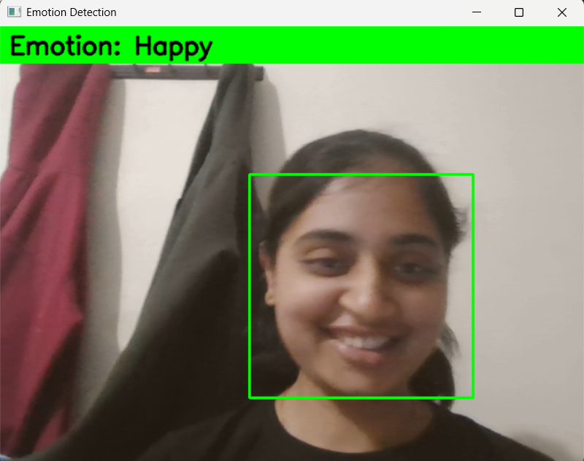
Module 3: Analysis and Output
Module 3.1 : Emotion Detection Using Trained CNN
Functionality: Takes preprocessed grayscale face images and passes them into a trained CNN model to predict the dominant emotion.
💡Detected Emotion: “Happy” using a trained CNN model. Displayed in real- time using OpenCV with bounding box and overlay text.

Slide 11

Module 3.2 : Emotion Aggregator & Decision Logic
Functionality: Collects predicted emotions over ~50 frames and picks the most frequently occurring emotion to stabilize detection.
💡 Above is a screenshot of the user selecting a preferred language after emotion detection

Slide 12
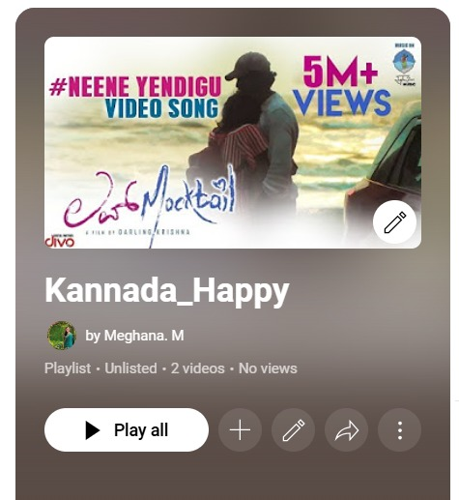
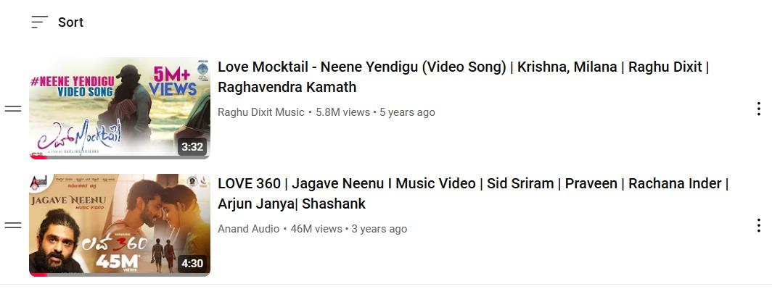
Module 3.3: Playlist Mapper
Functionality: Based on the final detected emotion and user-selected language, fetches the corresponding YouTube playlist URL from a predefined dictionary and opens it.
🎬 Above is the automatically generated playlist based on detected emotion and selected language.

Slide 13
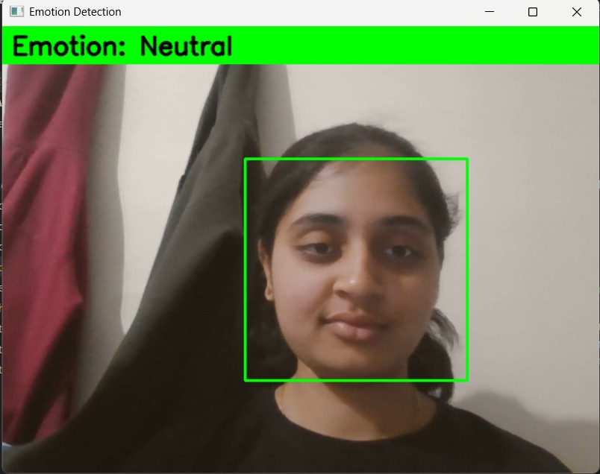
Module 3.4: Real-Time User Interaction & Display
Functionality: Displays emotion on webcam video stream with visual indicators like a green banner and emotion text.
💡Emotion ("Neutral") detected and visually confirmed before playlist generation.

Slide 14
Tools And Technologies To Be Used
1. Development Tools:
Visual Studio– For coding and testing the machine learning model.
2. Programming Language:
Python – For implementing facial recognition and the music recommender system.
3. Frameworks & Libraries:
OpenCV – For face detection and image processing.
TensorFlow / Keras – For building and training the emotion recognition model.
DeepFace / FER Library – For pre-trained facial emotion recognition models..
4. Additional Tools:
YouTube API – For fetching recommended songs.
5. Version Control:
Git, GitHub

Slide 15
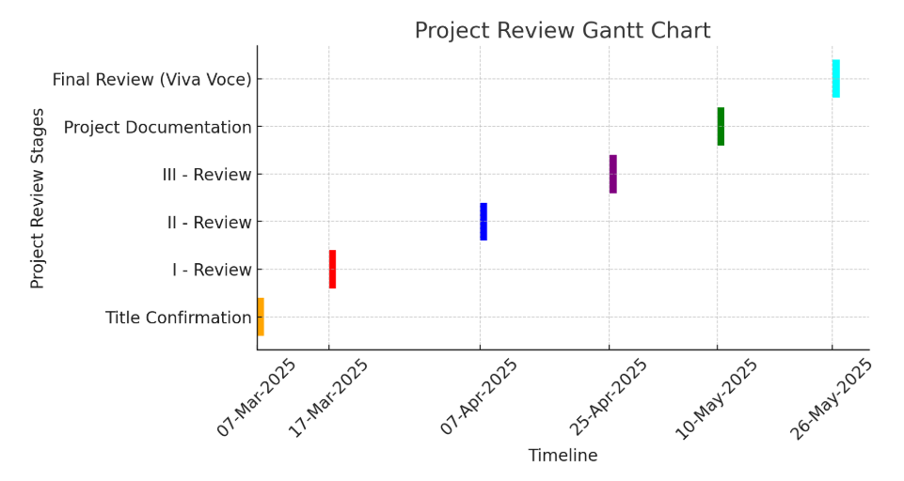
Timeline of the Project

Slide 16
GitHub Link
https://github.com/Meghana049/AI-Powered-Mood-Based-Music-Recommender-Using-Facial-Emotion-Recognition

Slide 17
References
E. Çano, R. Coppola, E. Gargiulo, M. Marengo, and M. Morisio, "Mood-based on-car music recommendations," in Proceedings of the 2nd EAI International Conference on Industrial Networks and Intelligent Systems (INISCOM), Leicester, UK, Oct. 31–Nov. 1, 2016, pp. 154–163.
A. V. Kumar, P. Kelkar, A. Agarwal, and V. R. B. Prasad, "PlayMyMood: Personalized hybrid music recommendation engine based on body monitoring parameters," presented at the International Conference on Advances in Computing, Communications and Informatics (ICACCI), 2021.
T. Bontempelli, B. Chapus, F. Rigaud, M. Morlon, M. Lorant, and G. Salha-Galvan, "Flow Moods: Recommending music by moods on Deezer," presented at the RecSys Challenge Workshop at the 16th ACM Conference on Recommender Systems, 2022.
T. Babua, R. R. Naira, and G. A, "Emotion-aware music recommendation system," in Proceedings of the 2023 International Conference on Intelligent Computing and Control Systems (ICICCS), 2023.

Slide 18
J. Brown and M. Taylor, "Mood-based music recommender using sentiment analysis on social media data," in Proceedings of the 2022 IEEE International Conference on Big Data (Big Data), 2022.
Y. Wang et al., "Personalized music recommender using speech emotion recognition," in Proceedings of the 2020 IEEE International Conference on Multimedia and Expo (ICME), 2020.
S. Lee et al., "Emotion-aware music recommendation using deep learning," in Proceedings of the 2019 IEEE International Conference on Data Mining (ICDM), 2019.
Z. Liu, W. Xu, and W. Zhang, "An emotion-based personalized music recommendation framework for emotion improvement," in Proceedings of the 2023 IEEE International Conference on Acoustics, Speech, and Signal Processing (ICASSP), 2023.

Slide 19


